Slide 1
CO₂ Emissions Management
Avoid, Reduce, Replace & Offset:
A Regenerative Travel Policy
Lisanne Havinga & Martin Brown
COST Action RESTORE
MGM, Limassol, 14/02/2020

Slide 2
CO₂ Emissions Management
Setting the agenda: the key principles of a Regenerative Travel Policy for RESTORE
Data Analysis & Tool
Policies: Avoid, Reduce, Replace & Offset
The RESTORE Manifest

Slide 3
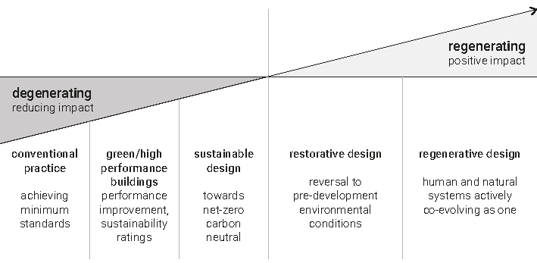
Regenerative Travel Policy
Aim of RESTORE: Having a positive environmental impact

Slide 4
Regenerative Travel Policy
However, we have to be conscious of our own impact.
We are emitting large amounts of CO₂
This meeting: 21.000 kg CO₂ for 37 people
570 kg CO₂/person

Slide 5
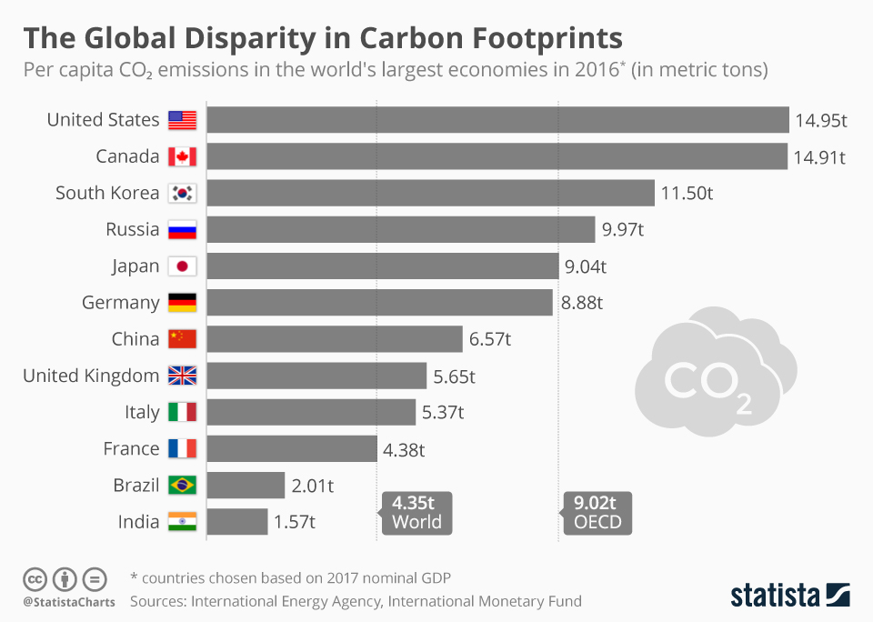
Regenerative Travel Policy
4x yearly
emissions p.p.
France/Italy/UK

Slide 6

Regenerative Travel Policy
21.000 kg CO₂ 567 kg CO₂/person
20 years
Eating vegetarian

Slide 7
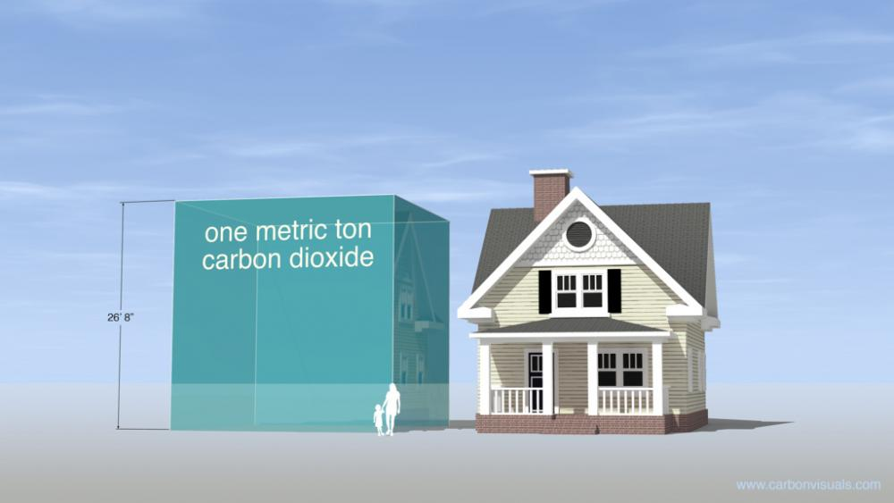
Volume of 21 detached homes

Slide 8
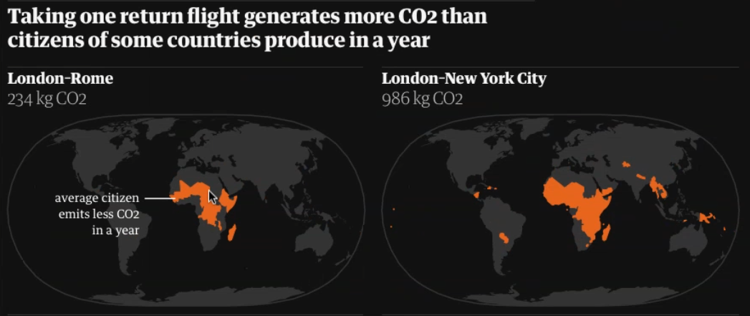

Slide 9
Regenerative Travel Policy
‘COP25: Controversial carbon markets take center stage’
allowing rich countries to get away with continuing to burn fossil fuels while paying poor countries to clean up.
Greenpeace: “We do not have the luxury of talking about carbon offsets, we need absolute emissions cuts now. Offsetting is unacceptable in the face of the scale and pace of emissions reductions required, and we will oppose the creation of a new global carbon market”

Slide 10
Regenerative Travel Policy
RIBA Challenge:
Reduce embodied carbon by at least 50-70%, before UK offsetting

Slide 11
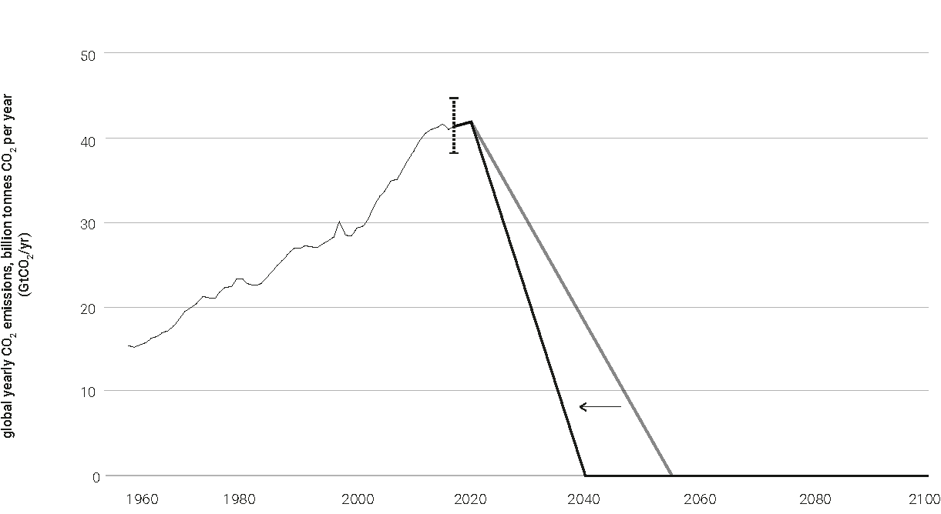
Regenerative Travel Policy
Limited timeframe to limit emissions. Emit now, offset later is not a solution to the challenge we face.

Slide 12
Regenerative Travel Policy
Take into account the ‘Hand’print in stead of Footprint
  What outcomes are achieved by the activities?
  What is the result of e.g. educating young professionals and academics in a trainingschool?
  What is the result of publishing articles and books on regenerative sustainability?

Slide 13
Regenerative Travel Policy
Key principles:
Avoiding, Reducing and Replacing CO₂ emissions
Offset any remaining CO₂ emissions in a timely manner, using reliable CO₂ offset programs
Overall environmental impact should be positive, meaning no remaining CO₂ emissions, combined with our positive ‘handprint’ of enhancing and disseminating knowledge about regenerative sustainability and design.

Slide 14
Data Analysis & Tool
  Historical CO₂ Emissions
    Rough Estimate based on three previous meetings
  Future CO₂ Emissions
    Gathering More Accurate Data
    Reducing Footprint

Slide 15
Data Analysis & Tool
Footprint per person: assessment of three meetings
Riga 13.800 kg CO₂ 430 kg CO₂/person
Eindhoven 2.900 kg CO₂ 160 kg CO₂/person
Cyprus 21.000 kg CO₂ 570 kg CO₂/person
So: It’s all about location!

Slide 16
Data Analysis & Tool
Footprint per person: assessment of three meetings
Riga 13.800 kg CO₂ 430 kg CO₂/person
Eindhoven 2.900 kg CO₂ 160 kg CO₂/person
Cyprus 21.000 kg CO₂ 570 kg CO₂/person
So: It’s all about location!
500 kg CO₂
/person

Slide 17
Data Analysis & Tool
Going from a rough calculation to a more precise calculation: The Tool!

Slide 18
Data Analysis & Tool
Going from a rough calculation to a more precise calculation: The Tool!

Slide 19
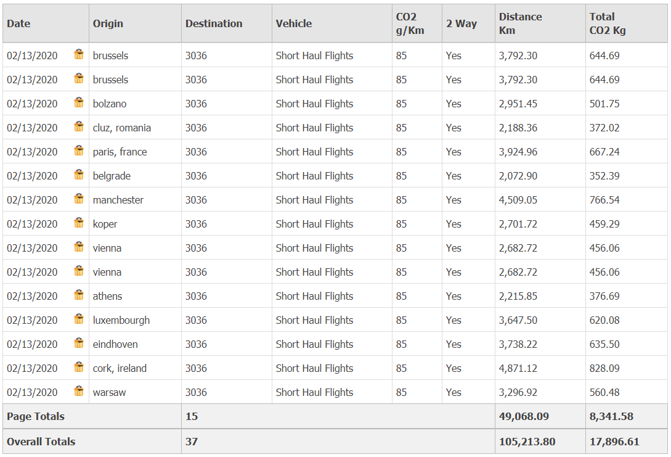

Slide 20
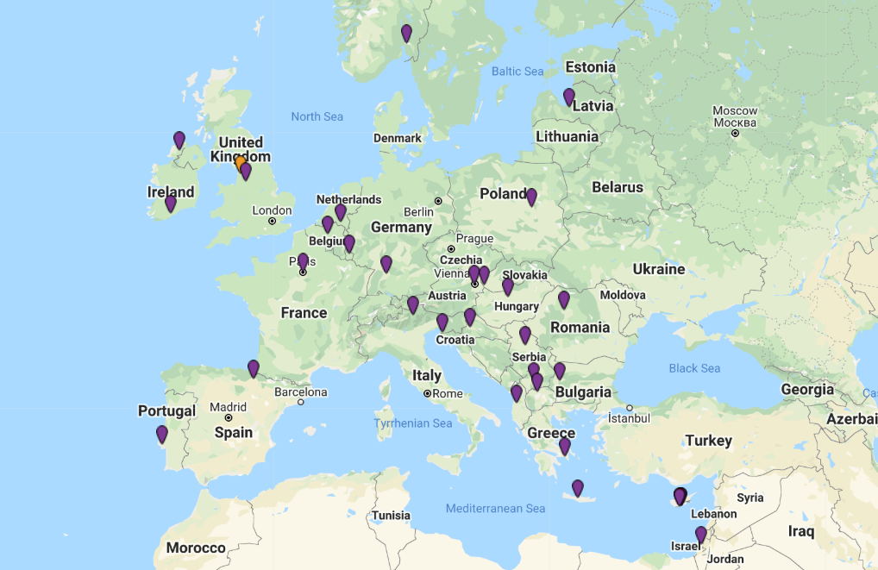

Slide 21
ARRO: Avoid, Reduce, Replace, Offset
offset
reduce
replace
avoid

Slide 22
Avoid
Web-based options for ‘low handprint’ activities
Encourage dial-in options (Skype / Go to Meeting)
Web-based dissemination activities such as webinars, MOOC’s, etc.

Slide 23
Reduce
Combining meetings and activities, both of RESTORE, as well as combinations with other external events
Consider the CO₂ impact of possible locations, and select a location that has a good combination of a positive ‘handprint’ and low footprint.

Slide 24
Replace
Consider low-carbon transport (e.g. train)
Consider direct flight instead of a connecting flight
Consider low-budget airlines who typically have a lower carbon footprint
Discourage flights for short distance travel (<300 km, for example Amsterdam-Brussels, Milan-Venice, Budapest-Vienna, etc., or where there is a direct train connection

Slide 25
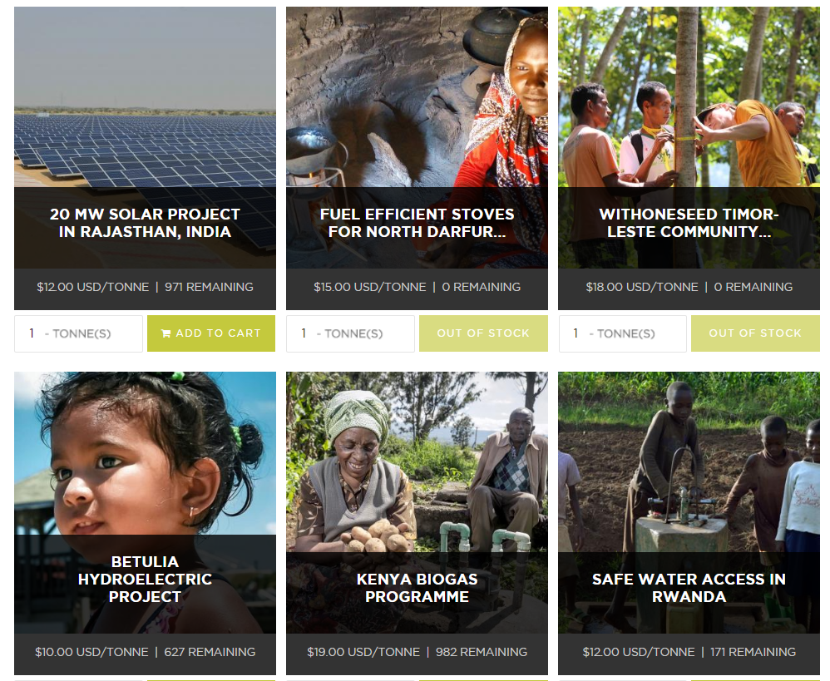

Offset
Solar
Wind
Forests
Clean & Safe Water
Clean & Safe Cooking

Slide 26
Offset
Offset remaining emissions, in addition to emissions that have already taken place
RESTORE will suggest a few reliable and short-term offsetting schemes, to offset remaining emissions within 15 years
Voluntary contributions

Slide 27
Offset
Past activities: €20 per participant. This will seek to offset the CO₂ emissions of the first three grant periods
Upcoming meetings, €10-15 per participant. (Or €5 if past activities are already offsetted)

Slide 28
Offset
Long distance travels (e.g. >5.000 km / to other continents) specific contribution (€10-25)
All contributions are made individually and voluntary. Receipts (‘proof’) sent to CO2 Management of RESTORE
Newsletter and website lists updates on progress, including a list of contributors to the offsetting scheme

Slide 29
RESTORE Manifest
RESTORE aims to avoid, reduce and replace at least 50% of the CO₂ emissions associated with upcoming activities, being the final grant period
Moreover, RESTORE aims to offset all remaining CO₂ emissions, making RESTORE carbon-neutral
Including our positive ‘handprint’, RESTORE’s impact is regenerative

Slide 30
Thank you for your attention!
どうもありがとう
Lisanne Havinga & Martin Brown
Limassol, 14/02/2020

